Slide 1
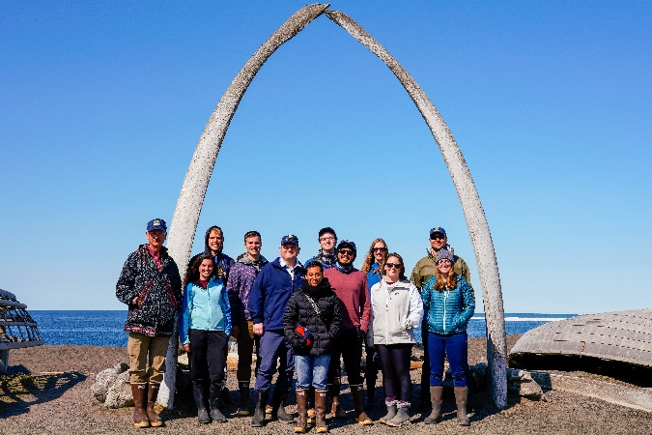
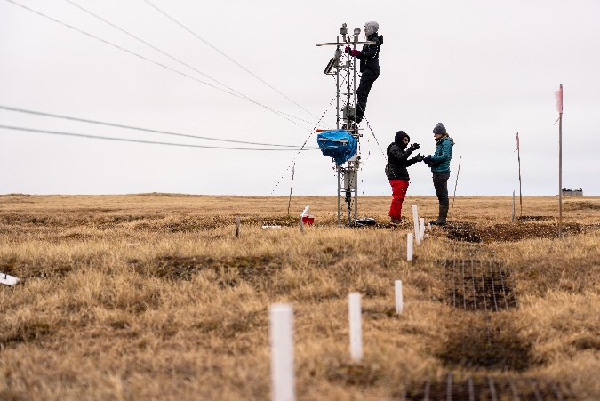
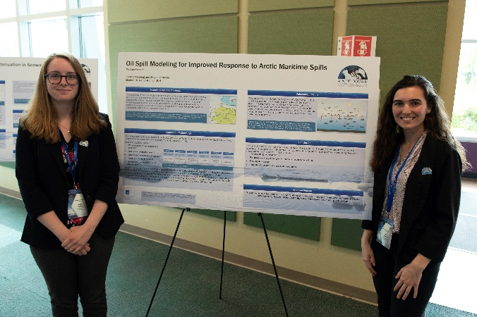
ADAC Year 6 Annual Meeting
...Via Conference Call, 14 May 2020
ADAC Project Briefing
ADAC’s Education Programs
Ellee Matthews, ADAC Education & Administrative Manager

Slide 2
Integration Education Overview
ADAC Program Year 6 Annual Meeting 14 May 2020
Education outreach and workforce development is a core mission for ADAC. The intent of ADAC’s education program is to contribute to the next generation of Science, Technology, Engineering, and Mathematics (STEM) professionals for the Homeland Security Enterprise (HSE). ADAC’s geographic focus on the Arctic is unique in the DHS S&T OUP portfolio. The Arctic focused research led by ADAC offers ADAC fellows a variety of unique research and development opportunities to engage with research aimed specifically to respond to the challenges faced by the USCG and other DHS maritime missions operating in the High North.

Slide 3
ADAC Education Program: Structure
ADAC Program Year 6 Annual Meeting 14 May 2020
ADAC Fellowship Program
Workforce Development (WFD) Fellowship Program
Integrated Minority Serving Institute (MSI)/Arctic Summer Internship Program (ASIP)
The ADAC Education Program is comprised of two major components:

Slide 4
Workforce Development (WFD) Fellowship Program
ADAC Program Year 6 Annual Meeting 14 May 2020
ADAC’s WFD Fellows are funded via a DHS S&T OUP Cooperative Grant
Project Objectives:
Attract the highest caliber undergraduate and graduate students to our science and engineering programs at UAA.
Nurture and train these students for careers in DHS — related applied fields of science and technology.
Provide students opportunities for direct involvement in DHS operations and embedded research among our DHS collaborators and stakeholders.
Provide education and mentorship to students that leads to timely completion of degrees and fulfilling careers in DHS Enterprise.
Potential Impact:
Contribute to growth of highly skilled workforce for Homeland Security agencies.
Contribute to the capability of US Coast Guard operator and in support of USCG missions in the Arctic.
MSI/ASIP Program
Workforce Development(WFD)
Fellowship Program
ADAC Education Program

Slide 5
Integrated Minority Summer Internship (MSI)/Arctic Summer Internship Project (ASIP)
ADAC Program Year 6 Annual Meeting 14 May 2020
Project Description:
The Arctic Summer Internship/Minority Summer Internship integrates students from under-represented classifications with designated Minority Serving Institutions (MSI) and Significant Minority Enrollment (SME) institutions. These interns join additional participating ADAC Fellows for a comprehensive summer internship program centered on Arctic field research.
ASIP is a comprehensive 10-week internship conducted by the ADAC team that provides students with the opportunity to network with multiple U.S. Federal Agencies, industry professionals, academics, Arctic operators, and Arctic community members. The internship also offers the opportunity to participate in ADAC research, independent research, and field research conducted in the U.S. Arctic. ** Due to COVID-19, the 2020 internship will take place virtually.
Objective/Purpose:
To provide an Arctic focused summer internship program oriented for MSI’s, under-represented classifications, and other ADAC Fellows as a means of student workforce development and preparation for entry into the Homeland Security Enterprise or related field.
MSI/ASIP Program
Workforce Development (WFD)
ADAC Education Program

Slide 6
ADAC Education Program: Eligibility, Commitment, & Support
ADAC Program Year 6 Annual Meeting 14 May 2020
ADAC Education Program is open to undergraduate, graduate and advanced graduate students. The following apply to all fellows:
Eligibility requirements:
◦ U.S. citizenship
◦ STEM major
◦ Clear background check
◦ Achieve & maintain a cumulative GPA of 3.30
Commitment:
◦ Complete two 10-week summer internships while in the program.
◦ Actively seek and obtain employment in the Homeland Security Enterprise or a related field for at least one year after graduation.
Note: Employment can be at the state, federal or local level. Undergraduate Fellows can also defer employment to attend graduate school.
Support:
◦ Monthly stipend and tuition support (fall & spring semesters only) at defined levels for undergraduate & graduate students.
◦ Assistance in securing a 10-week internship for two summers.
◦ Mentoring and professional development through ADAC network.

Slide 7
Current Status: ADAC’s Workforce Development (WFD) Fellowship Program
ADAC Program Year 6 Annual Meeting 14 May 2020

Slide 8
Program Year 6 WFD Fellowship Milestones & Metrics
ADAC Program Year 6 Annual Meeting 14 May 2020
Milestones
Performance Metrics
Outreach & Exchange
  Participate in professional exchanges and outreach activities, this includes workshops (Arctic IoNS, MaLTE, local or national research symposiums), and Center meetings with DHS constituents.
Center Activities
  Attend monthly meetings with Center Leadership.
  In collaboration with Project PI’s and ADAC Education & Administrative Manager, develop individual student work plans for their corresponding projects.
Summer Internships
  Participate in one 10-week summer internship (one/summer during Fellowship).
GPA meets DHS requirements (3.30 on 4.0 scale).
Track progress of graduated Fellows accredited to DHS enterprise careers, with program graduates who are unable to gain employment.
Compare Fellows completion of required 10-week internships.
Graduated Fellows have one year to secure employment in the Homeland Security Enterprise (federal/state/local gov. etc.).

Slide 9
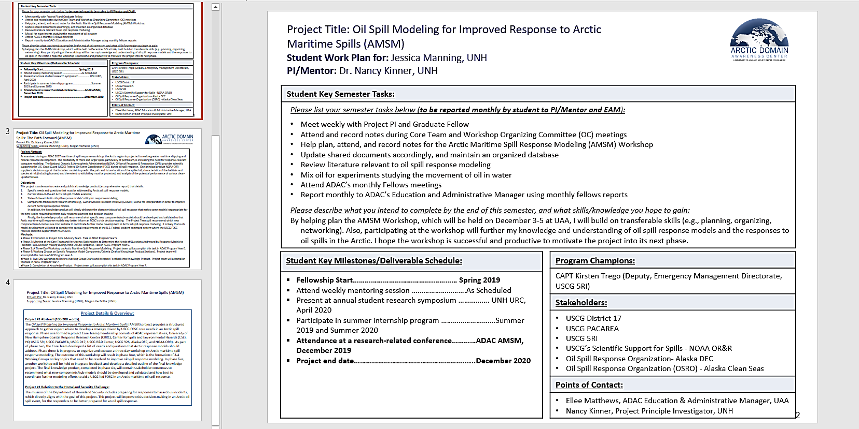
ADAC Project Engagement: Work Plans
ADAC Program Year 6 Annual Meeting 14 May 2020
Each Fellow has an individually developed work plan for their engagement in an ADAC project, Center led activities, or both.
Developed in collaboration with Project PI/Lead, ADAC Fellow, ADAC Executive Director, and ADAC Education & Administrative Manager.
Revisited after each semester.

Slide 10
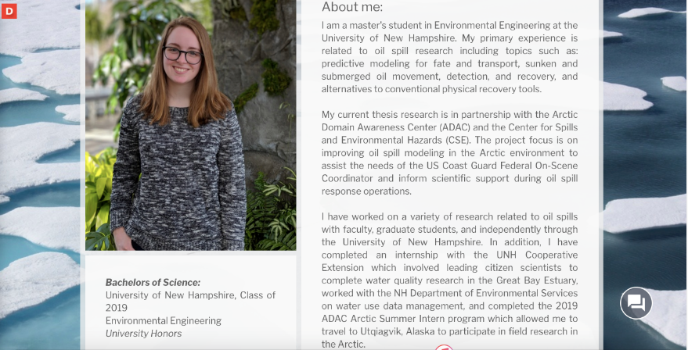

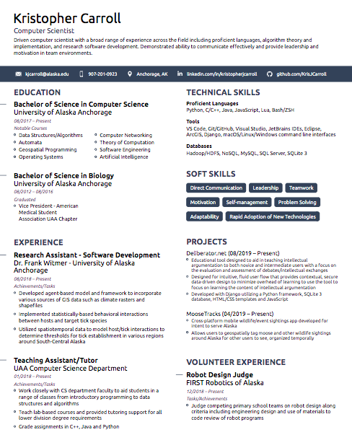

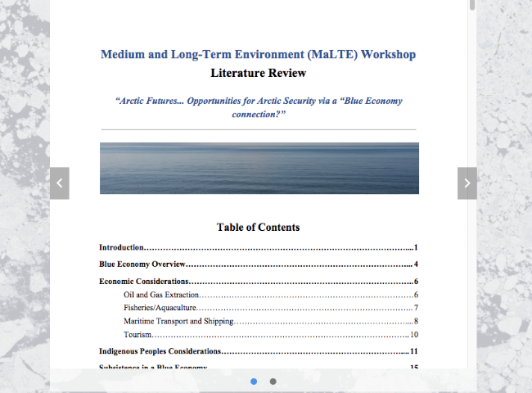
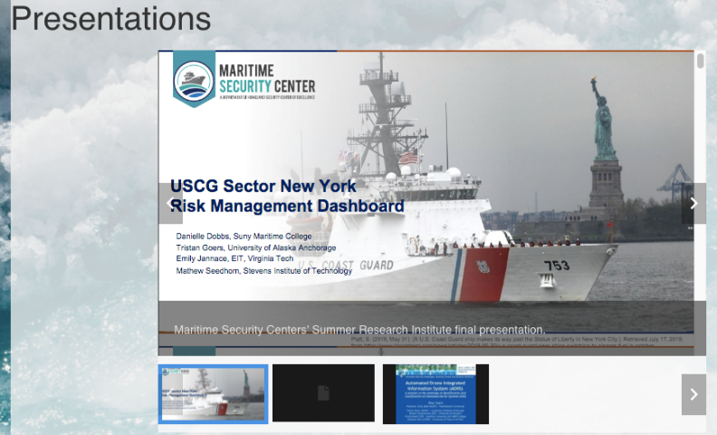
ADAC Fellows ePortfolios
ADAC Program Year 6 Annual Meeting 14 May 2020
ePortfolios are a new online platform to showcase ADAC’s student fellows and their work.
The ADAC Fellows ePortfolios include:
  Student Biography
  Career Goals
  Academic Courses
  Resume
  Publications
  Presentations
  Extracurricular Activities
ADAC to post ePortfolios to the Center’s Website before the end of Program Year 6.

Slide 11
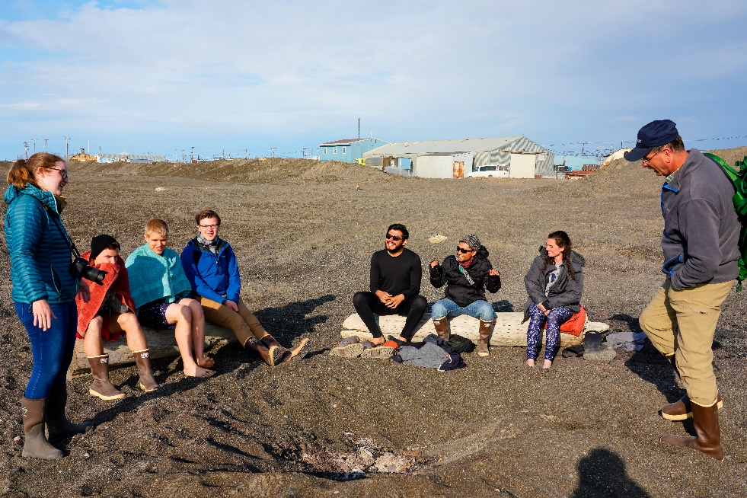
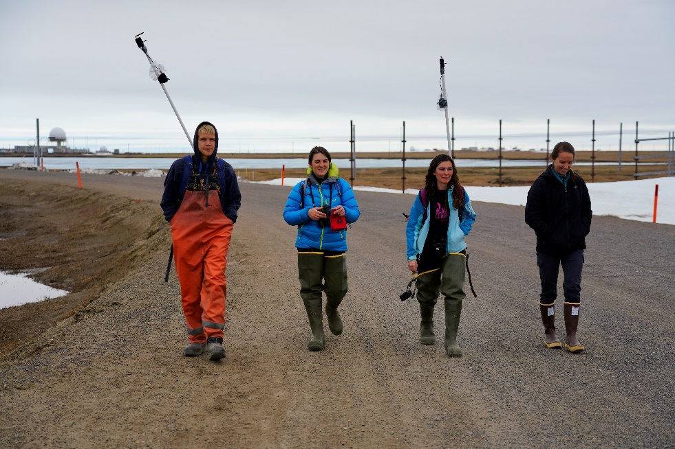
Current Active ADAC Fellows - Program Year 6
ADAC Program Year 6 Annual Meeting 14 May 2020
Arctic Domain Awareness Center - Program Year 6 Overview of Current Supported Fellows
 | University of Alaska Anchorage, AK (UAA) | University of Texas at El Paso, TX (UTEP)* | University of New Hampshire (UNH)
Undergraduate | 4 | 2 | 1
Graduate | 4 | 0 | 1
Total | 8 | 2 | 2
Total Overall Active Fellows: | 12
* An accredited MSI institution

Slide 12
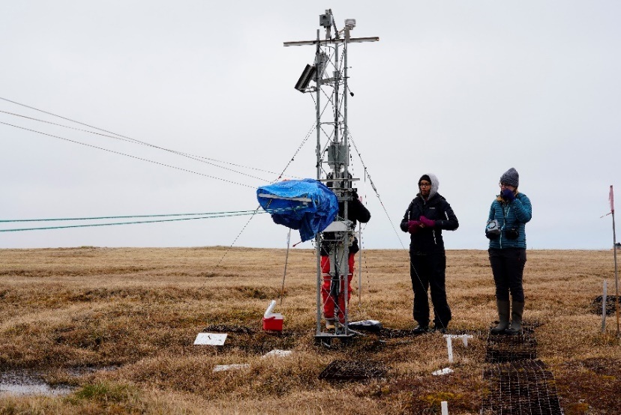
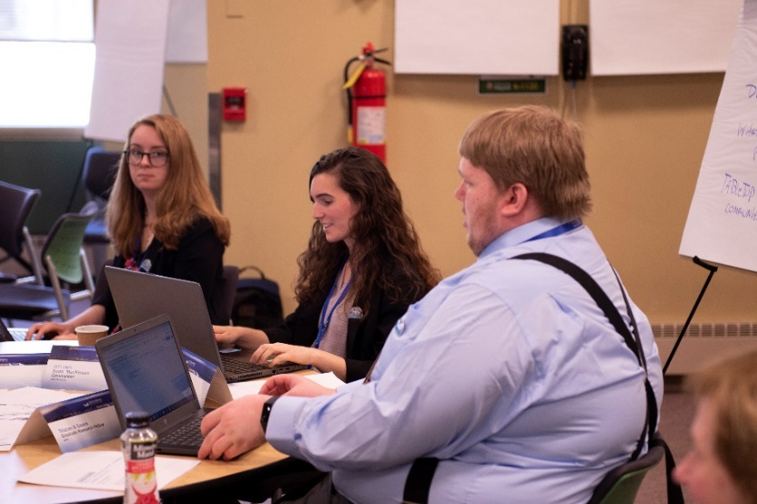
Outreach, Exchange, & Activities
ADAC Program Year 6 Annual Meeting 14 May 2020
Student Research Presentations:
  Past:
    July 2019 – COE Summit at George Mason University, VA
    December 2019 – Arctic Oil Spill Response Modeling Workshop in Anchorage, AK
    January 2019 – Arctic Marine Science Symposium in Anchorage, AK
  Upcoming:
    ADAC 2020 Arctic Summer Internship Program Presentations
Center-Specific Projects & Activities:
  Past:
      November 2019 - 2019 ALCOM Symposium and Report
      December 2019 – Visit made by the Senior Official Performing the Duties of the Undersecretary for Science and Technology (SOPDUSST) to ADAC
  Upcoming:
      May 2020 – ADAC’s Program Year 6 Virtual Annual Meeting
      June – August 2020 – ADAC’s Virtual Arctic Summer Internship Program
  Attendance at monthly mentoring meetings with ADAC Leadership Team

Slide 13
Current Student Research Engagement in ADAC Projects
ADAC Program Year 6 Annual Meeting 14 May 2020
Project Name | Fellow(s) on Project | University
Arctic Vessel Monitoring/Geofencing: | Undergrad. Fellows Raul Reutov and Kristopher Carroll, and Jack McCaslin | UAA
Arctic Oil Spill Modeling Strategies | Undergrad. Fellow, Jessica Manning & Graduate Fellow, Megan Verfaillie | UNH
Arctic Mussels | Undergrad. Fellow Cameron Carlson & Graduate Fellows, Stacey Hanson and Kevin Fitzpatrick | UAA
ICECON for the Great Lakes | Undergrad. Fellow Rachel Lewis | UAA
Arctic ICECON | Undergrad. Fellow Kristopher Carroll | UAA
Assisting USCG Sector Anchorage with the Arctic and Western Alaska Area Committee | Graduate Fellows Kelly Ireland and Tristan Goers | UAA
UTEP Projects | Undergrad. Fellows Hector Dominguez and Brenda Almanza | UTEP

Slide 14
Upcoming Ten -Week Summer Internships
ADAC Program Year 6 Annual Meeting 14 May 2020
Each of ADAC’s current Fellows are confirmed for their summer 2020 internships (all 2020 summer internships will be executed using distance technology):
  12 ADAC Fellows – Virtual Integrated MSI/ASIP Internship
  2 ADAC Fellows – Virtual Internship with Bigelow Laboratories for Ocean Sciences
  1 ADAC Fellow – Virtual Woods Hole Partnership Educational Program
  1 ADAC Fellow – Virtual Internship at UAA on Dr. Caixia Wang’s Machine Learning Project
  1 ADAC Fellow – Virtual Internship at UAA on Dr. Kathryn Milligan-Myhre Crude Oil Bioremediation Project

Slide 15
Current Status: Summer 2020 Integrated Minority Summer Internship and Arctic Summer Internship Program
ADAC Program Year 6 Annual Meeting 14 May 2020

Slide 16
Program Year 6 – Summer 2020 Integrated MSI & ASIP
ADAC Program Year 6 Annual Meeting 14 May 2020
Milestones
Performance Metrics
Recruit five students from under-represented minorities to participate in ADAC’s Arctic Summer Internship.
Outline expectations and opportunities for recruited students.
*Original Milestone: Recruited students will travel to Anchorage for ASIP’s orientation and briefing portion, and then proceed to Utqiagvik for the program’s field portion.
  *Updated Milestone to adapt to COVID-19: Recruited students will participate an a virtual orientation week, followed by 9 weeks of comprehensive activities involving independent research projects, group projects, professional presentations for ADAC’s constituent base, workforce development, and a comprehensive series of guest lectures.
Recruiting five students from under-represented minorities.
Visiting minority students who then decide to compete for DHS CoE student intern program is considered a “success.”
Minority students who follow-on through a student relationship to a DHS CoE who then successfully graduates and enters into employment with the HSE or related field is considered a “success.”

Slide 17
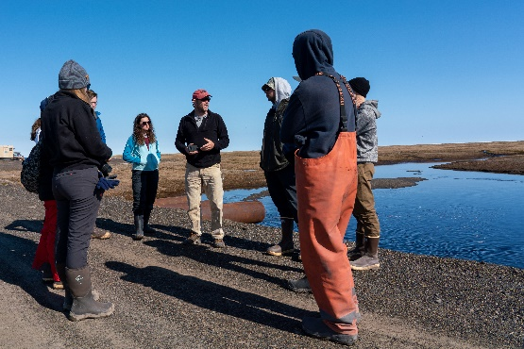
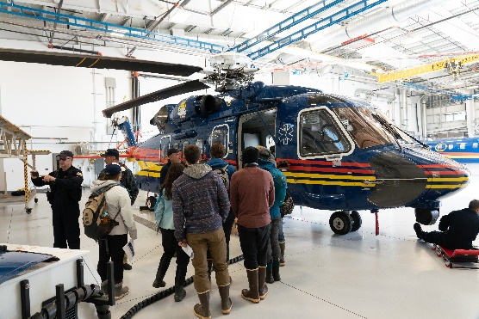
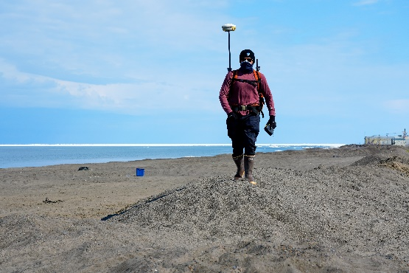
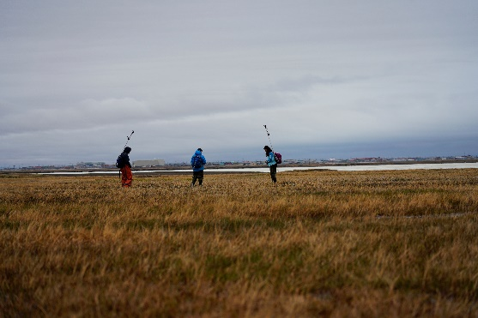
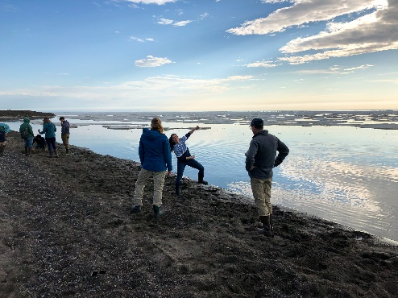
MSI/ASIP Virtual Program 2020: Overview
ADAC Program Year 6 Annual Meeting 14 May 2020
Program Leadership: PI – Dr. Craig Tweedie (UTEP); Co-PI – Ellee Matthews
Dates: June 1 – August 7
Delivery: Microsoft Teams, Zoom, and Google Calendar
Students:
  12 Total Students:
    6 University of Alaska Anchorage Students
    1 U.S. Naval Academy Midshipman
    1 University of Texas El Paso Student
    1 University of New Orleans Student
    1 University of North Carolina Wilmington Student
    2 University of New Hampshire Students

Slide 18
MSI/ASIP Virtual Program 2020: Components & Structure
ADAC Program Year 6 Annual Meeting 14 May 2020
Program Components
Program Structure
Professional Development
Group Project
Week 1
Orientation
Weeks 2-3
Arctic Alaska
Weeks 4-5
U.S. Arctic Focus
Week 6
International Arctic Focus
Week 7
Arctic Disasters and Response
Week 8
Arctic Innovations and Technology
Week 9
Student Presentations Week
Week 10
Program Wrap-Up and Professional Development Focus
Student Presentations
Weekly Guest Presentations
Independent Research Project
Virtual ASIP Program
Weekly Lectures

Slide 19
Graduated ADAC Fellows and Interns in Program Year 6
ADAC Program Year 6 Annual Meeting 14 May 2020
Student | University | Degree | Where are they now?
Summer 2019
Sarah Gering | UAA | M.S. in Biology | Graduating with her M.S. this summer; to begin a PhD at the University of CO, Boulder in Ecology and Evolutionary Biology; NSF Graduate Fellowship Award recipient
Luke Cota | USNA | B.S. in Oceanography | Graduating from the USNA this spring; to begin flight school in October to become a Navy Pilot
Grace Santella | USNA | B.S. in Oceanography | Completing her B.S. degree, with plans to become a commissioned naval officer in 2021
Andrew Segalla | USCGA | B.S. in Political Science | Graduating from the USCGA this spring, to begin flight school in Pensacola, CA
Fall 2019
Max Zaki | UAA | B.S. in Electrical and Mechanical Engineering | Completing dual B.S. degrees, while also completing an M.S. in Mechanical Engineering
Kelsey Frazier | UAA | B.S. and M.S. in Mechanical Engineering | ADAC Research Associate on the ARCTICE Project; to pursue a PhD in Engineering at UAF/UAA
Daniel Cruz | UTEP | B.S. in Mechanical Engineering | M.S. Student at UTEP in Computer Science
Spring 2020
Kristopher Carroll | UAA | B.S. in Computer Science | Full Scholarship Research Assistantship at UAA for an M.S. in Geospatial Data Science to begin Fall 2020

Slide 20

In Summary…
ADAC Program Year 6 Annual Meeting 14 May 2020
In Program Year 6 so far, 8 students have graduated from ADAC’s Education Program.
ADAC has had 3 MSI ADAC Fellows throughout Program Year 6.
Career options and interest have been looked at on individual basis, and mentoring by ADAC staff has been tailored to assist graduates to transition to Homeland Security Enterprise related employment.

